Slide 1
SECURE DATA HIDING IN IMAGES USING STEGANOGRAPHY
CAPSTONE PROJECT
Presented By: Rohith B
Student Name : Rohith B
College Name : College of Engineering Guindy (CEG), Anna University
Department: B.E Computer Science and Engineering

Slide 2
OUTLINE
Problem Statement
Technology used
Wow factor
End users
Result
Conclusion
Git-hub Link
Future scope

Slide 3
Problem Statement
With the increasing need for data security and privacy, traditional encryption techniques can sometimes be too conspicuous, making them easy targets for attackers. This project aims to develop a steganography-based application that allows users to hide secret text messages within images, making the communication of sensitive information more discreet and secure.

Slide 4
Technology used
Programming Language: Python
GUI Framework: Tkinter
Image Processing: Pillow (PIL)
Steganography Library: Stegano (LSB technique)
File Handling: OS, Sys

Slide 5
Wow factors
Graphical User Interface (GUI): Easy-to-use and intuitive interface for both hiding and retrieving messages.
Secure Message Hiding: Uses password protection to ensure that only authorized users can access the hidden message.
Minimal Image Distortion: Ensures that image quality is preserved while embedding the secret message.
Standalone Application: Can be converted into an executable for deployment without requiring Python installation.

Slide 6
End users
Individuals who need to securely communicate confidential messages.
Journalists and whistleblowers who require discreet communication channels.
Cybersecurity enthusiasts exploring data hiding techniques.
Students and researchers studying steganography.

Slide 7
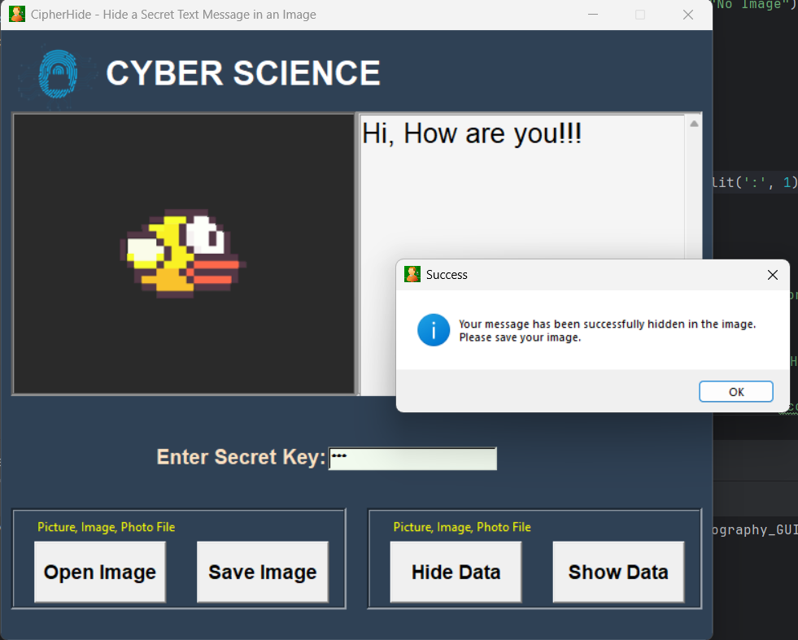
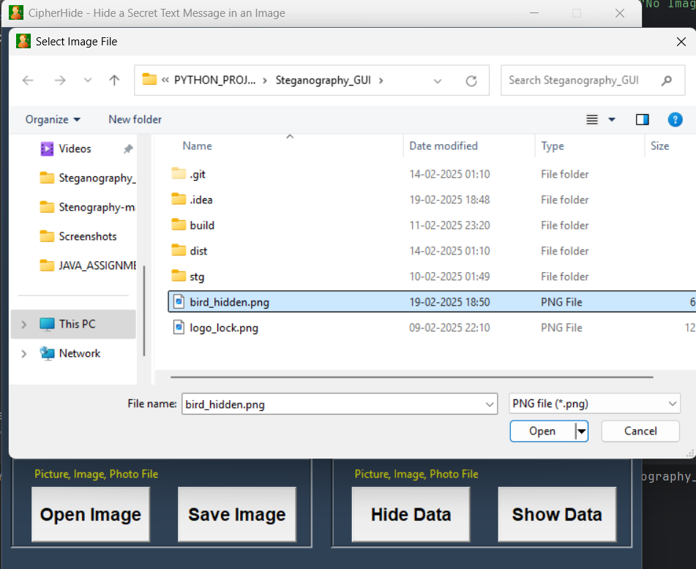
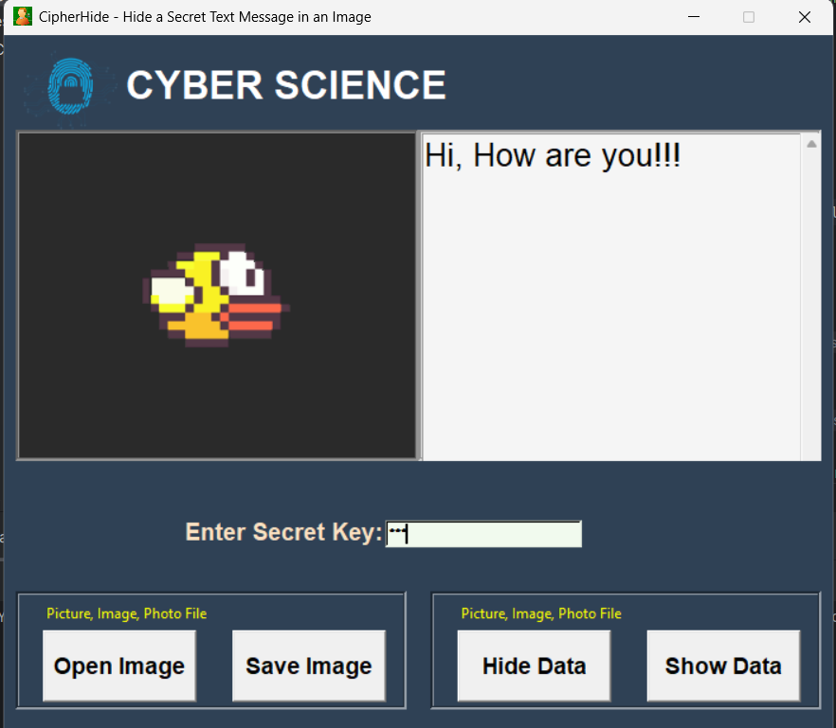
Results

Slide 8
Conclusion
This project demonstrates how steganography can be used to enhance data privacy by hiding messages within images. It provides an intuitive and effective method for secure communication while maintaining image integrity. Future improvements could include support for additional file formats and advanced encryption techniques.

Slide 9
GitHub Link
Link to GitHub Repository

Slide 10
Future scope(optional)
Integration with Encryption: Adding an additional layer of encryption for enhanced security.
Support for Multiple File Formats: Extending support beyond PNG and JPG to other formats like BMP and GIF.
Cloud Integration: Enabling cloud storage and retrieval of hidden messages.
Mobile Application: Developing an Android/iOS version for ease of access.
Audio and Video Steganography: Expanding beyond images to support hiding messages in audio and video files.

Slide 11
THANK YOU

